Slide 1
Simplifying AI Model Deployment Using Streamlit for Rapid Prototyping and User Interaction

Slide 2
Streamlit ဆိုတာဘာလဲ?
streamlit သည် Python ဖြင့် Web Application များကို အလွယ်တကူ ဖန်တီးနိုင်သော Framework တစ်ခု ဖြစ်သည်။
Data Science, Machine Learning နှင့် Analytics General web App နယ်ပယ်များအတွက် အထူးသင့်လျော်ပါသည်။
import streamlit as st st.write('Hello, streamlit!')

Slide 3
Streamlit ကို ဘာကြောင့် ရွေးချယ်သင့်သလဲ?
ရိုးရှင်းသော Python စာကြောင်းများဖြင့် Web App တည်ဆောက်နိုင်ခြင်း ။
မိနစ်ပိုင်းအတွင်း Deploy လုပ်နိုင်ခြင်း ။
Interactive Widgets များကို အလွယ်တကူ ထည့်သွင်းနိုင်ခြင်း ။
UI / UX များ Responsive ဖြစ်ခြင်း။

Slide 4
Streamlit ကို Install လုပ်ပုံ
pip install streamlit
import streamlit as st
st.write("Hello, World!")
Run command :
streamlit run app.py

Slide 5
Streamlit UI Components
Write Components
Text
Data elements
st.write()
st.write_stream()
st.markdown()
st. title()
st.header()
st.subheader()
st.badge()
st.caption()
st.code()
st.echo()
st.latex()
st.text()
st.divider()
st.help()
st.html()
st.dataframe()
st. data_editor()
st.table()
st.metric()
st.json()

Slide 6
Streamlit UI Components
Charts elements
Media elements
st.area_chart()
st. bar_chart()
st.line_chart()
st.scatter_chart()
st.map()
st.pyplot()
st.altair_chart()
st.vega_lite_chart()
st.plotly_chart()
st.bokeh_chart()
st.pydeck_chart()
st.graphviz_chart()
st.image()
st. logo()
st.audio()
st.video()
st.json()

Slide 7
Streamlit UI Components
Input widegts
Input widegts
st.button()
st. download_button()
st.form_submit_button()
st.link_button()
st.page_link()
st.checkbox()
st.color_picker()
st.feedback()
st.multiselect()
st.pills()
st.radio()
st.segmented_control()
st.selectbox()
st.select_slider()
st.toggle()
st.number_input()
st.slider()
st.date_input()
st.time_input()
st.chat_input()
st.text_area()
st.text_input()
st.audio_input()
st.file_uploader()
st.camera_input()

Slide 8
Streamlit UI Components
Layouts and containers
Chat elements
status elements
st. columns()
st. container()
@st.dialog()
st. empty()
st. expender()
st.popover()
st. sidebar()
st.tabs()
st.chat_input()
st. chat_message()
st.progress()
st. spinner()
st.status()
st.toast()
st.ballons()
st.snow()
st.success()
st.info()
st.warning()
st.error()
st.exception()

Slide 9
Streamlit UI Components
Navigation and pages
Execution flow
Caching and state
st.navigation()
st. page()
st. page_link()
st. switch_page()
st. form()
@st. fragment()
st.rerun()
st.stop()
@st. cache_data()
@st. cache_resource()
st. session_state()
st. query_params()
st. context.cookies()

Slide 10
Streamlit UI Components
Custom Components
st.navigation()
st. page()
st. page_link()
st. switch_page()

Slide 11
Streamlit UI Components
Configuration
Authentication and User Info
.streamlit/config.toml
st.get_option()
st.set_option()
st.set_page_config()
st.login()
st.logout()
st.user()

Slide 12
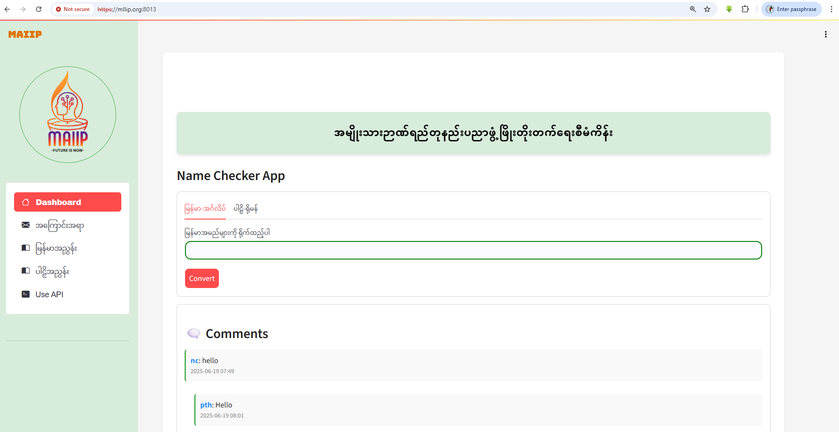
Streamlit UI with Master Template

Slide 13
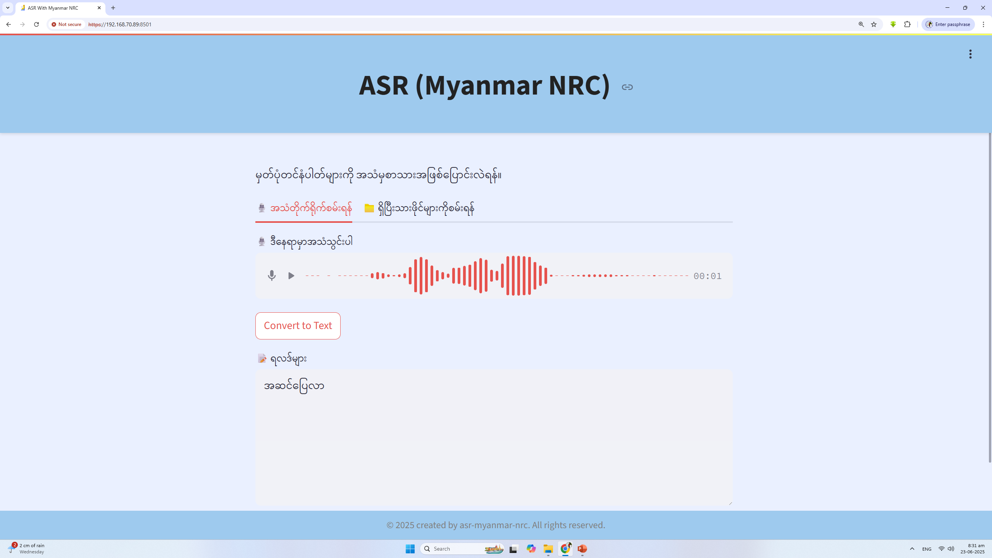
Streamlit Ui with ASR

Slide 14
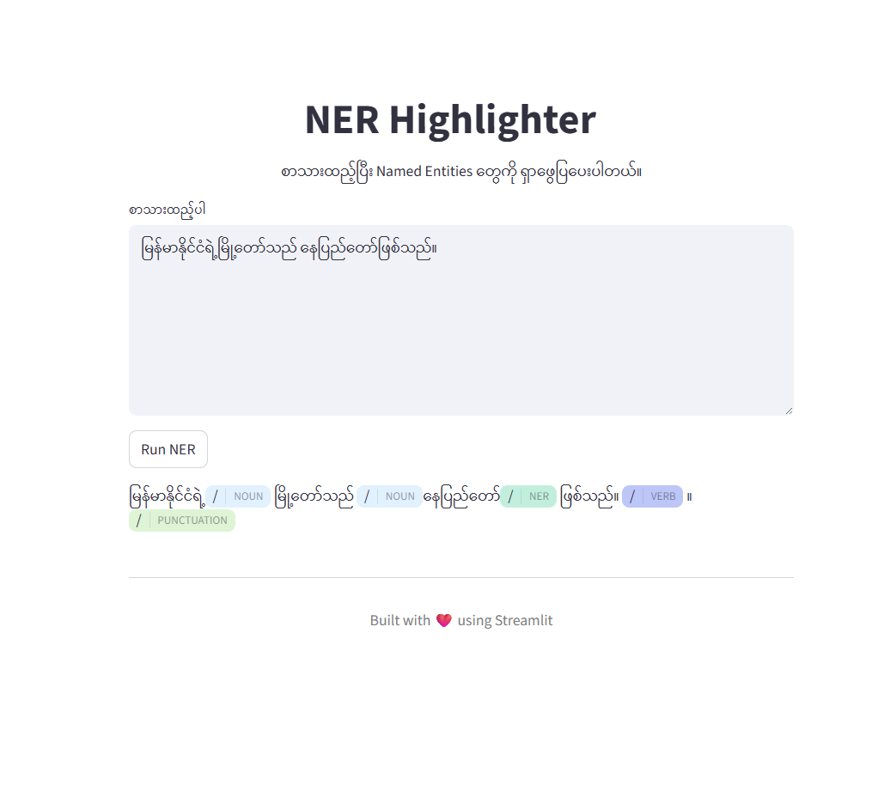
Streamlit Ui with NER / Tagging
pip install st-annotated-text

Slide 15
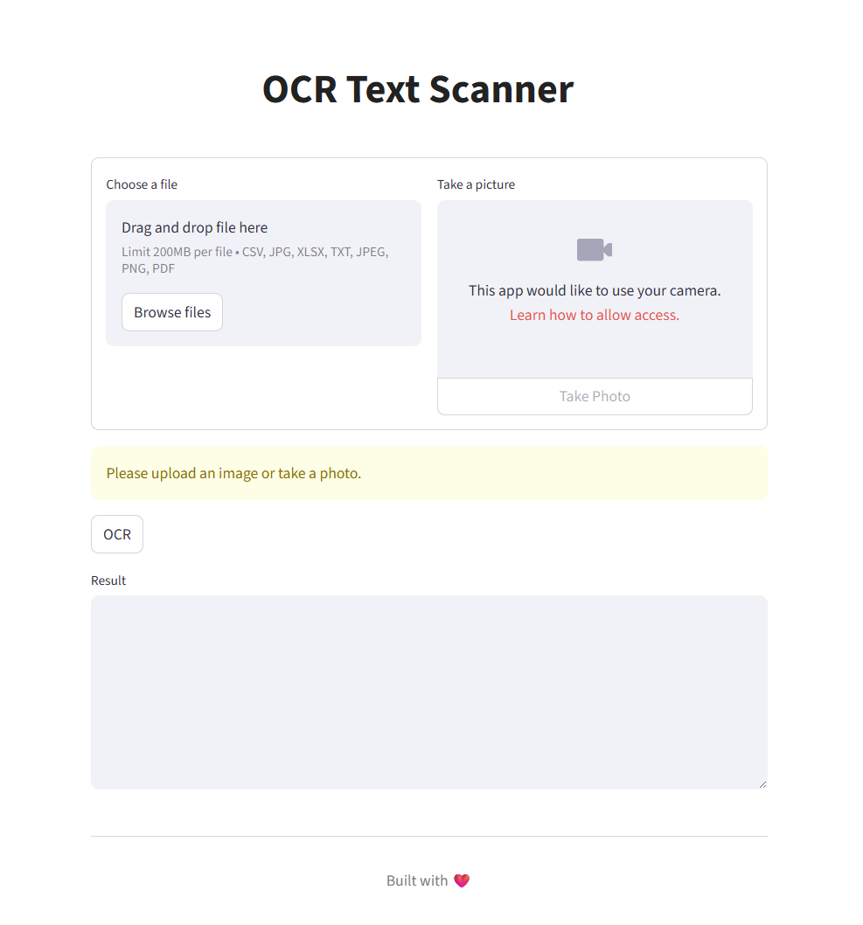
Streamlit Ui with OCR

Slide 16
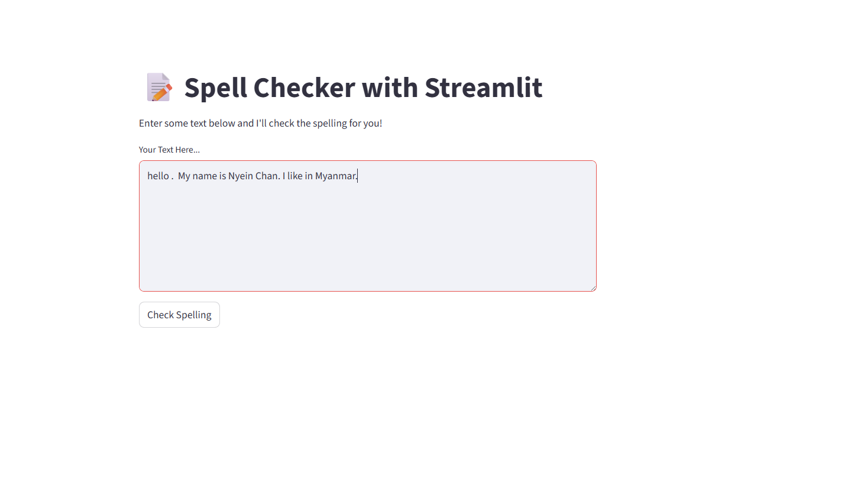
Spell Checking

Slide 17
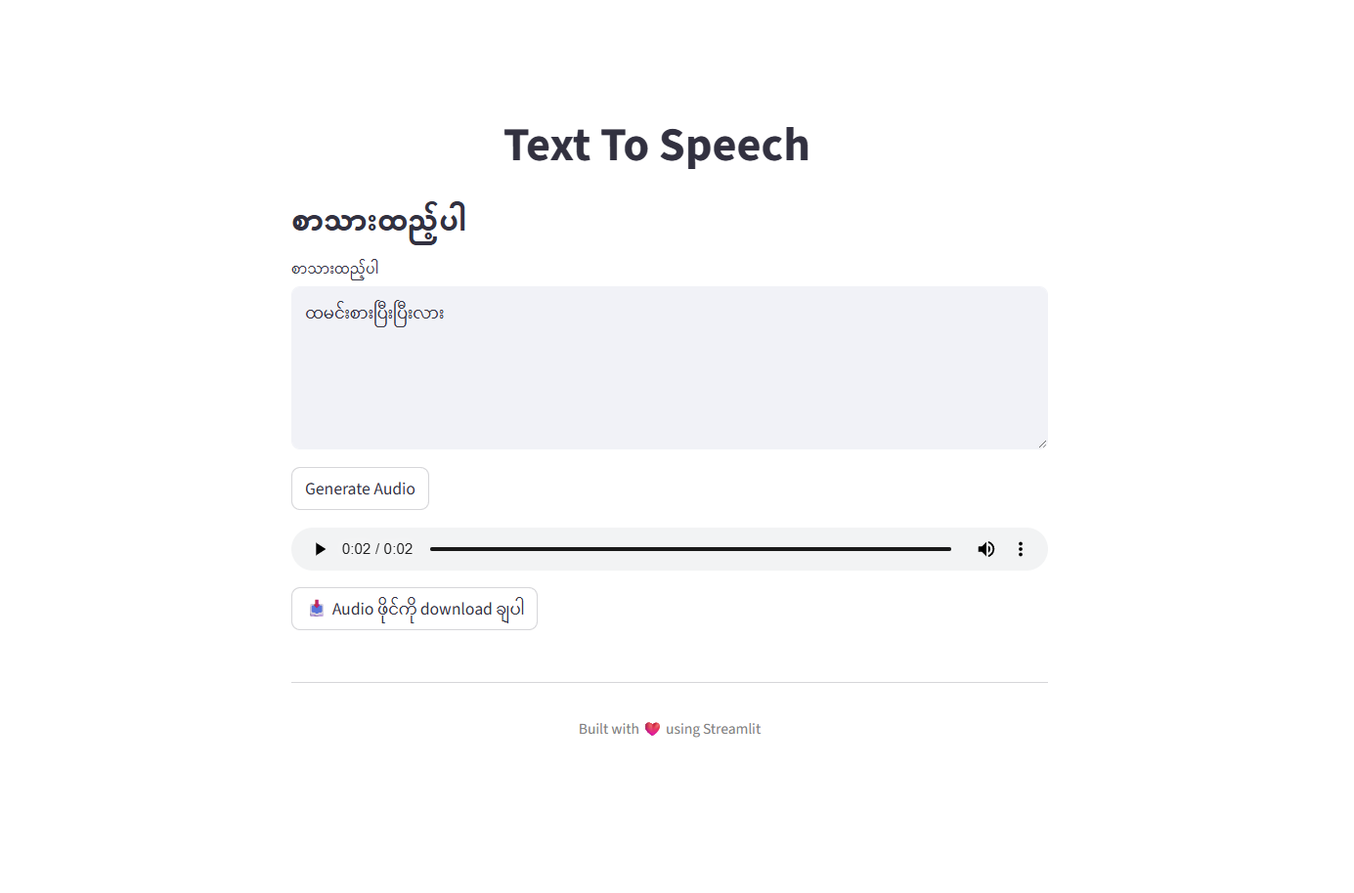
Streamlit Ui with TTS

Slide 18
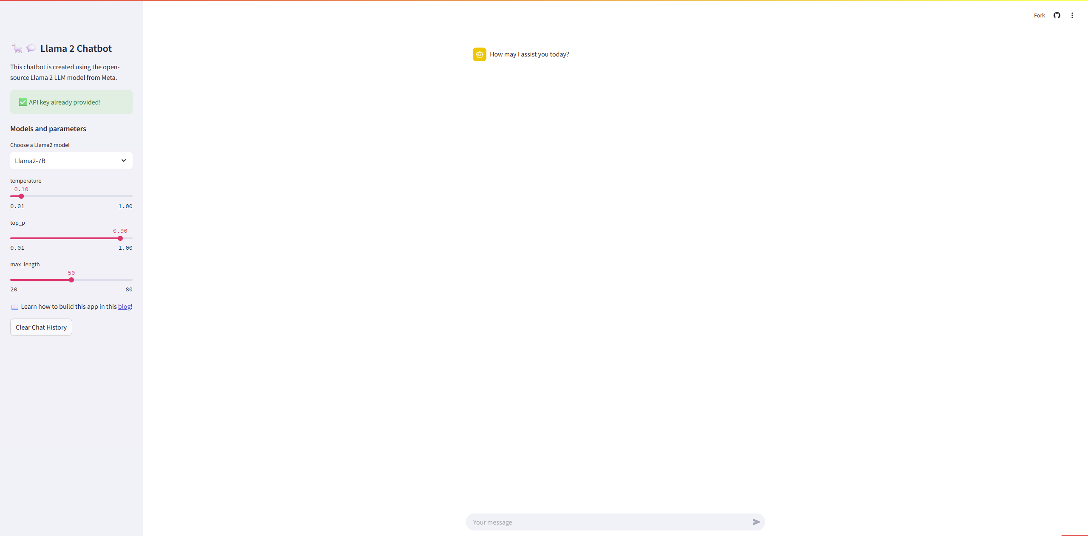
Streamlit Ui with ChatGPT

Slide 19
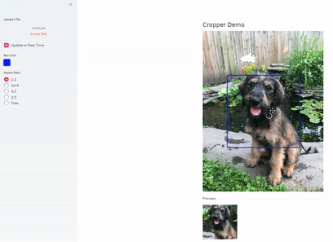
Image Cropper
pip install streamlit-cropper

Slide 20
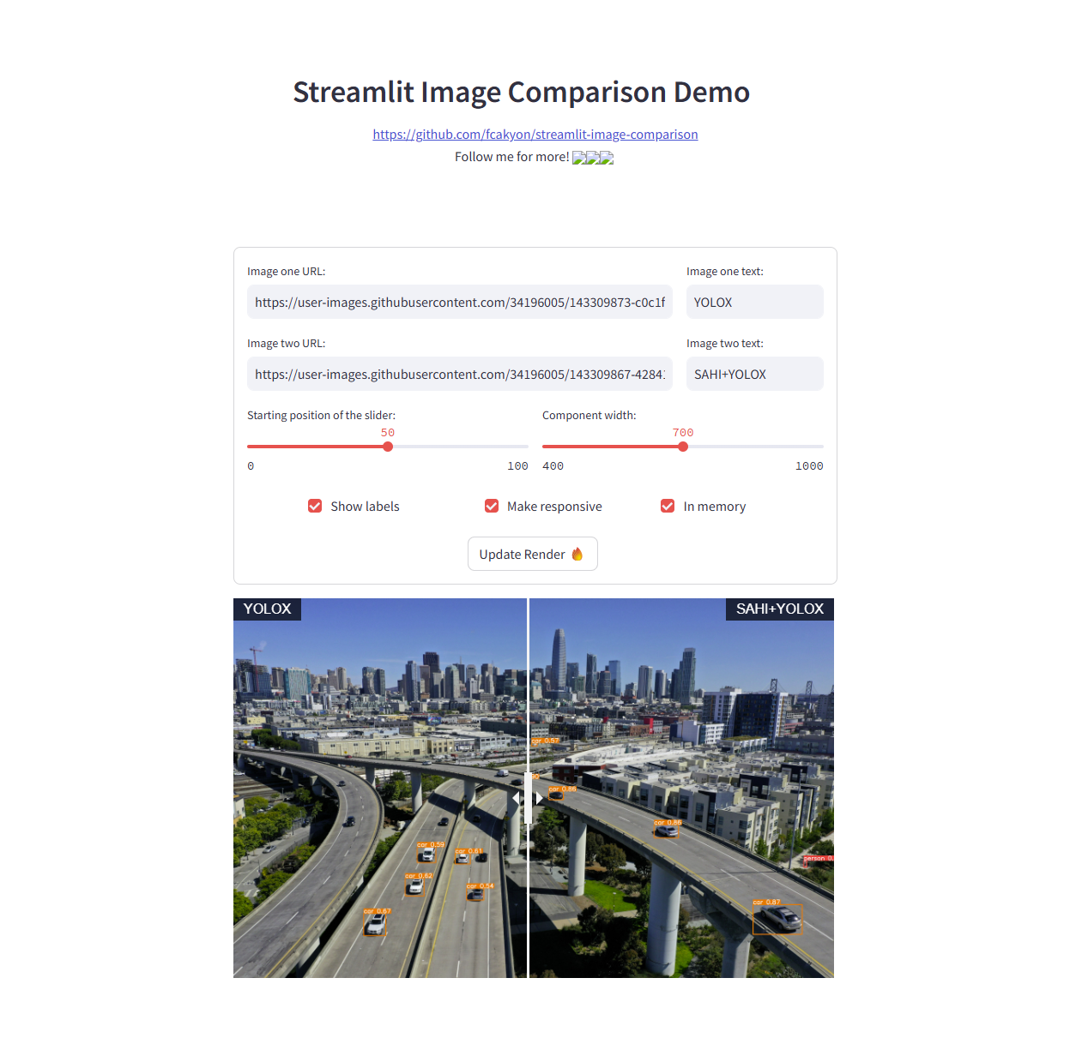
Image Comparison
pip install streamlit-image-comparison

Slide 21
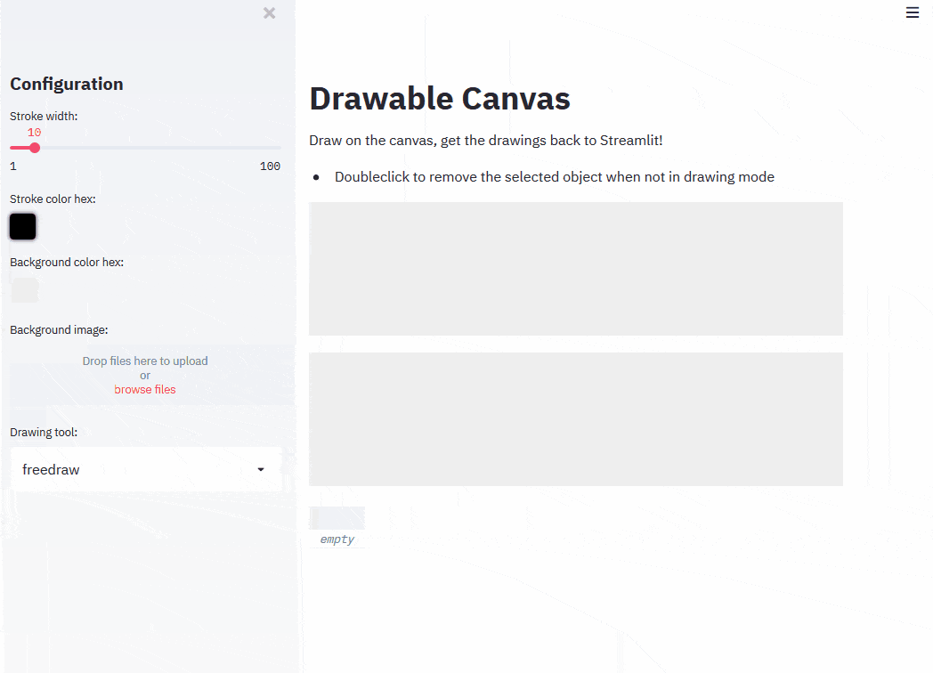
Drawable Canvas
pip install streamlit-drawable-canvas

Slide 22
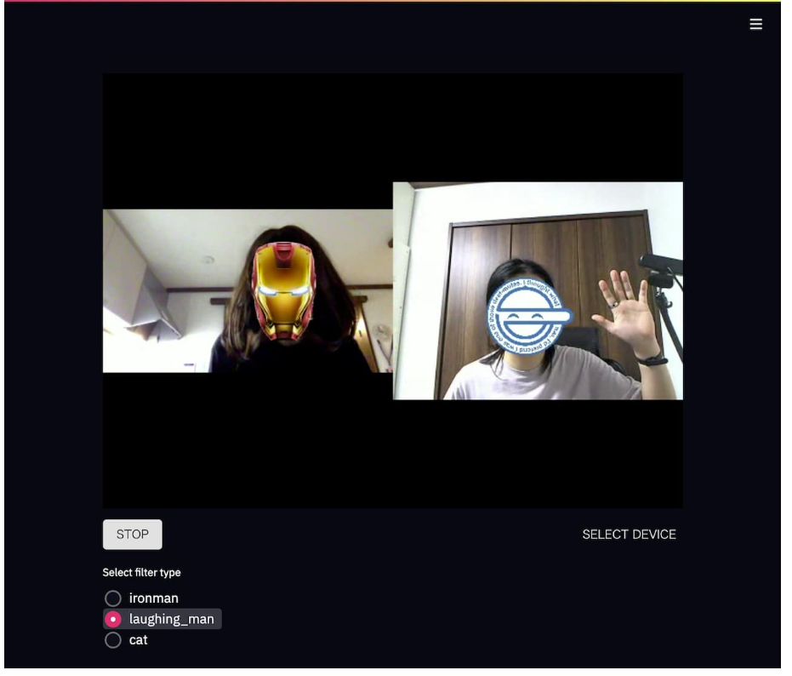
Realtime Camera Detection
pip install -U streamlit-webrtc

Slide 23
Connect Streamlit to SQLite Server
import sqlite3
sqlite3.connect(db_path, check_same_thread=False)

Slide 24
Connect Streamlit to MSSQL Server
pip install pyodbc
Mssql server install
Import pyodbc
pyodbc.connect(
"DRIVER={ODBC Driver 17 for SQL Server};" "SERVER=your_server_name_or_ip;"
"DATABASE=your_database_name;“
"UID=your_username;"
"PWD=your_password"
)

Slide 25
Connect Streamlit to MYSQL Server
pip install mysql-connector-python
mysql server install
import mysql.connector
mysql.connector.connect(
**{ "host": "localhost",
"user": "root",
"password": "your_password",
"database": "your_database"
})

Slide 26
Connect Streamlit to Mongo Server
pip install pymongo
mongo server install
from pymongo import MongoClient
MongoClient("mongodb://localhost:27017")

Slide 27
General Notes
streamlit run .\appl.py --server.address=0.0.0.0 --server.port=8000 --server.sslCertFile=cert.pem --server.sslKeyFile=key.pem (https:// server ထောင်ရင်)
Permission accept တွေလိုရင် https:// server ကို ထောင်ပေးပါ။

Slide 28
.streamlit/config.toml
[server]
port = 80
sslCertFile = '/path/to/certchain.pem' sslKeyFile = '/path/to/private.key'
enableStaticServing = true
[client]
showErrorDetails = true[theme] base="dark" primaryColor="forestGreen" [theme.sidebar] primaryColor="darkGoldrod"
[browser]
gatherUsageStats = false
[theme]
base="dark" primaryColor="forestGreen“
[theme.sidebar] primaryColor="darkGoldrod"
[theme] base="light" backgroundColor="white" secondaryBackgroundColor="lavender" codeBackgroundColor="powderBlue" [theme.sidebar] backgroundColor="ghostWhite" secondaryBackgroundColor="lavender“
[theme] base="dark" textColor="darkGoldenrod" linkColor="darkOrchid"[theme] base="dark" textColor="darkGoldenrod" linkColor="darkOrchid"

Slide 29
.streamlit/config.toml
[theme] base="light" primaryColor="slateBlue" backgroundColor="mintCream" secondaryBackgroundColor="darkSeaGreen" baseRadius="full" [theme.sidebar] backgroundColor="aliceBlue" secondaryBackgroundColor="skyBlue" baseRadius="none“
[theme] base="dark" borderColor="mediumSlateBlue" showWidgetBorder=false [theme.sidebar] showWidgetBorder=true
[theme] font = "sans-serif" headingFont = "sans-serif" codeFont = "monospace" [theme.sidebar] font = "sans-serif" headingFont = "sans-serif" codeFont = "monospace“
[theme] baseFontSize=16
[theme] codeFontSize="0.875rem"

Slide 30
အားလုံးကို ကျေးဇူးတင်ရှိပါတယ်?????

